Slide 2
PART 4
Scalable Architecture Practices

Slide 3
CHAPTER 19
Architecturally Significant Requirements

Slide 4
Chapter Outline
Introduction
Gathering ASRs from Requirements Documents
Gathering ASRs by Interviewing Stakeholders
Gathering ASRs by Understanding the Business Goals
Capturing ASRs in a Utility Tree
Change Happens
Summary

Slide 5
Introduction
Architectures exist to build systems that satisfy requirements.
To an architect, not all requirements are created equal.
An architecturally significant requirement (ASR) is a requirement that will have a profound effect on the architecture.
You cannot hope to design a successful architecture if you do not know the ASRs.
ASRs often, but not always, take the form of quality attribute requirements—the performance, security, modifiability, availability, usability, and so forth.
How do we find those?

Slide 6
19.1 ASRs from Requirements Documents
An obvious location to look for candidate ASRs is in the requirements documents or in user stories.
Requirements should be in requirements documents!
Unfortunately, this is not usually the case.
Why?

Slide 7
Don’t Get Your Hopes Up
Many projects don’t create or maintain the kind of requirements document that professors in classes love to prescribe.
No architect just sits and waits until the requirements are “finished” before starting work. The architect must begin while the requirements are still in flux.
The QA requirements are quite likely to be uncertain when the architect starts work.

Slide 8
Don’t Get Your Hopes Up
Even where they exist and are stable, requirements documents often fail an architect in two ways:
Quality attributes, even when captured, are often captured poorly.
“The system shall be modular”
“The system shall exhibit high usability”
These are not useful requirements because they are not testable
Much of what is useful to an architect is not in even the best requirements document.
Stakeholders, the technical environment, and the organization itself all play a role in influencing architectures.
For example, you will rarely see a requirements document that describes teaming assumptions.

Slide 9
Sniffing Out ASRs
The architect should perform a bit of investigation to extract ASRs from Requirements Document.
Look for information like:
Plans for teaming, skill sets, team coordination.
Network properties and configurations.
User roles, permissions, authentication.
Hardware choices
Data persistence requirements

Slide 10
19.2 ASRs from Interviewing Stakeholders
Say your project won’t have the QAs nailed down by the time you need to start your design work.
What do you do?
Stakeholders often have no idea what QAs they want in a system.
Experienced architects know what quality goals are realistic based on past projects.
Architects help stakeholders understand tradeoffs—like cost versus quality—and may even suggest better options than stakeholders expected.
Interviewing the relevant stakeholders is the surest way to learn what they know and need.

Slide 11
19.3 ASRs From Business Goals
Business goals are the reason systems are built.
Business goals are of interest to architects because they frequently lead directly to ASRs.
There are three possible relationships between business goals and an architecture:
Business goals often lead to quality attribute requirements.
Business goals may affect the architecture without inducing a quality attribute requirement at all.
For example, the manager wants to include a database, because the organization had a database unit employing a number of highly paid technical staff who were currently unassigned.
Not all business goals lead to quality attributes.

Slide 12
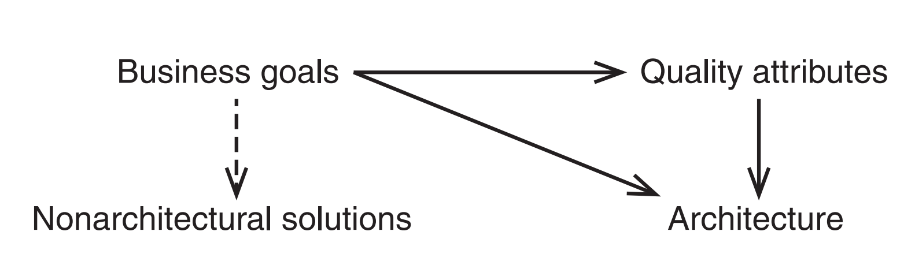
Some business goals may lead to quality attribute requirements, or lead directly to architectural decisions, or lead to non-architectural solutions.

Slide 13
Quality Attribute Workshop
The is a stakeholder-driven session to create and sharpen quality-attribute scenarios before finalizing the architecture.
The Quality Attribute Workshop (QAW) is a stakeholder-driven session to create and sharpen quality-attribute scenarios before finalizing the architecture.
The QAW involves the following elements:
Step 1: QAW Presentation and Introductions.
QAW facilitators describe the motivation for the QAW and explain each step of the method.
Step 2: Business/Mission Presentation.
The stakeholder representing the business concerns behind the system presents the system’s business context, broad functional requirements, constraints, and known quality attribute requirements.
The quality attributes that will be refined in later steps will be derived largely from the business/mission needs presented in this step.

Slide 14
Quality Attribute Workshop
Step 3: Architectural Plan Presentation.
The architect will present the system architectural plans as they stand.
This lets stakeholders know the current architectural thinking, to the extent that it exists.
Step 4: Identification of Architectural Drivers.
The facilitators will share their list of key architectural drivers that they assembled during Steps 2 and 3, and ask the stakeholders for clarifications, additions, deletions, and corrections.
The idea is to reach a consensus on a distilled list of architectural drivers that includes overall requirements, business drivers, constraints, and quality attributes.
Step 5: Scenario Brainstorming.
Each stakeholder expresses a scenario representing his or her concerns with respect to the system.
Facilitators ensure that each scenario has an explicit stimulus and response.
The facilitators ensure that at least one representative scenario exists for each architectural driver listed in Step 4.

Slide 15
Quality Attribute Workshop
Step 6: Scenario Consolidation.
Similar scenarios are consolidated where reasonable.
Consolidation helps to prevent votes from being spread across several scenarios that are expressing the same concern.
Step 7: Scenario Prioritization.
Prioritization of the scenarios is accomplished by allocating each stakeholder a number of votes equal to 30 percent of the total number of scenarios
Step 8: Scenario Refinement.
The top scenarios are refined and elaborated.
Facilitators help the stakeholders put the scenarios in the six-part scenario form of source-stimulus-artifact-environment-response-response measure.

Slide 16
19.3 ASRs From Business Goals
Architects often become aware of an organization’s business and business goals via osmosis—working, listening, talking, and soaking up the goals that are at work in an organization.
More systematic ways of determining such goals are both possible and desirable.
It is worthwhile to capture business goals explicitly, because they often imply ASRs that would otherwise go undetected until it is too late or too expensive to address them.
One way to do this is to employ the PALM method, which entails holding a workshop with the architect and key business stakeholders.
PALM consists of these steps
Step 1: Business goals elicitation.
Using the categories given later in this section to guide the discussion, capture from stakeholders the set of important business goals for this system.

Slide 17
19.3 ASRs From Business Goals
Step 2: Identify potential QAs from business goals.
For each important business goal scenario, have the participants describe a QA and response measure value that would help achieve the goal.
Using of categories for asking the stakeholders about business goals in each category, some assurance of coverage is gained.
Growth and continuity of the organization
Meeting financial objectives
Meeting personal objectives
Meeting responsibility to the employees
Meeting responsibility to society
Meeting responsibility to the state
Meeting responsibility to the shareholders
…

Slide 18
19.4 ASRs From Utility Tree
Architects can use a construct called a utility tree when the stakeholders are not available.
Of course, the real world, it is often the case that you do not have access to stakeholders when you need them.
A utility tree begins with the word Utility as the root node. Utility is an expression of the overall goodness of the system.
You then elaborate on this root node by listing the major QAs that the system is required to exhibit.
Under each QA, record specific refinements of that QA. For example, performance might be decomposed into “data latency” and “transaction throughput” or, alternatively, “user wait time” and “time to refresh web page”.
Under each refinement, you can then record the specific ASRs, expressed as QA scenarios.

Slide 19
19.4 ASRs From Utility Tree
Once the ASRs are recorded as scenarios and placed at the leaves of the tree, you can evaluate these scenarios against two criteria:
the business value of the candidate scenario
the technical risk of achieving it
You can use any scale you like, but we find that a simple “H” (high), “M” (medium), and “L” (low) scoring system suffices for each criterion.
For business value
high designates a must-have requirement
medium means the requirement is important but would not lead to project failure were it omitted,
low describes a nice requirement to meet but not something worth much effort.
For technical risk,
high means that meeting this ASR is keeping you awake at night
medium means meeting this ASR is concerning but does not carry a high risk
low means that you have confidence in your ability to meet this ASR.

Slide 20
19.4 ASRs From Utility Tree
Once you have a utility tree filled out, you can use it to make important checks. For instance:
A QA or QA refinement without any ASR scenario is not necessarily an error but rather an indication that you should investigate whether there are unrecorded ASR scenarios in that area.
ASR scenarios that receive a (H, H) rating are obviously the ones that deserve the most attention from you; these are the most significant of the significant requirements.

Slide 21
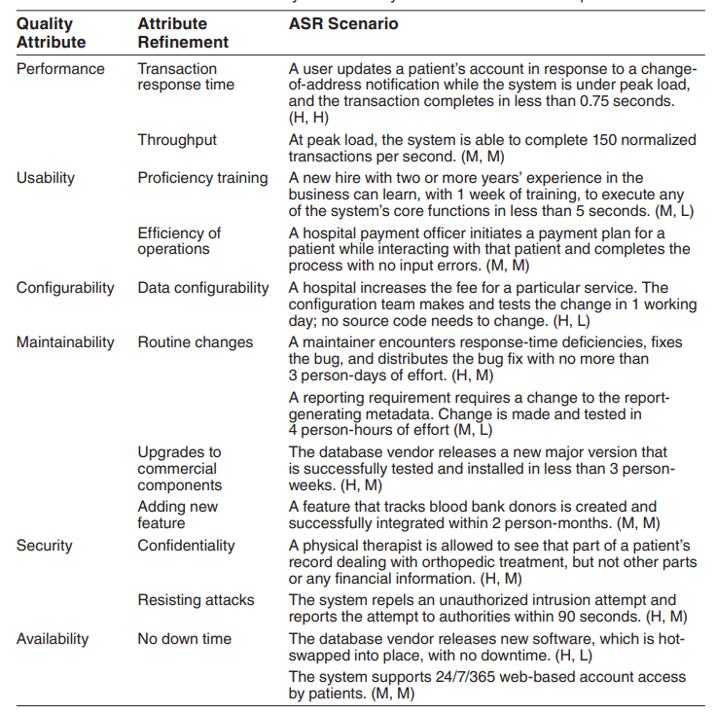
Tabular Form of the Utility Tree for a System in the Healthcare Space

Slide 22
19.5 Change Happens
Requirements—whether captured or not—change all the time.
Architects have to adapt and keep up, to ensure that their architectures are still the right ones that will bring success to the project.
Always keep a channel open to the key stakeholders who determine the ASRs so you can keep up with changing requirements.
Even better than keeping up with change is staying one step ahead of it.
If you get wind of a change to the ASRs, you can take preliminary steps to design for it to understand the implications.
If the change will be prohibitively expensive, sharing that information with the stakeholders will be a valuable contribution, and the earlier they know it, the better.

Slide 23
19.6 Summary
Architectures are driven by architecturally significant requirements: requirements that will have profound effects on the architecture.
Architecturally significant requirements may be captured from requirements documents, by interviewing stakeholders, or by conducting a Quality Attribute Workshop.
Be mindful of the business goals of the organization.
Business goals can be expressed in a common, structured form and represented as scenarios.
Business goals may be elicited and documented using a structured facilitation method called PALM.
A useful representation of quality attribute requirements is in a utility tree.
The utility tree helps to capture these requirements in a structured form.
Scenarios are prioritized.
This prioritized set defines your “marching orders” as an architect.

